Slide 1




PROphylaxis for paTiEnts at risk of
COVID-19 infection
Site Initiation Visit
Group 2 Site
Chief Investigator: Dr Rona Smith
V7.1

Slide 2

Outline
PROTECT-V trial
Sotrovimab
Study visits and assessment
Randomisation
Unblinding
Trial database

Slide 3
PROTECT-V trial rationale
Nationally prioritised platform (CUE-TIP study)
Pre-exposure prophylaxis
Vulnerable patient populations
  renal patients, transplant patients, renal autoimmune disease
  sotrovimab arm will also include oncology, haematology, primary immune deficiency patients, other autoimmune/autoinflammatory conditions
  Many of these patients mount sub-optimal responses to vaccination
Primary endpoint – symptomatic COVID-19 infection (either by PCR or lateral flow test)
Pragmatic
  Broad inclusion and exclusion criteria
  Minimal study visits
  Remote follow up and linkage with UKHSA (formerly PHE)

Slide 4
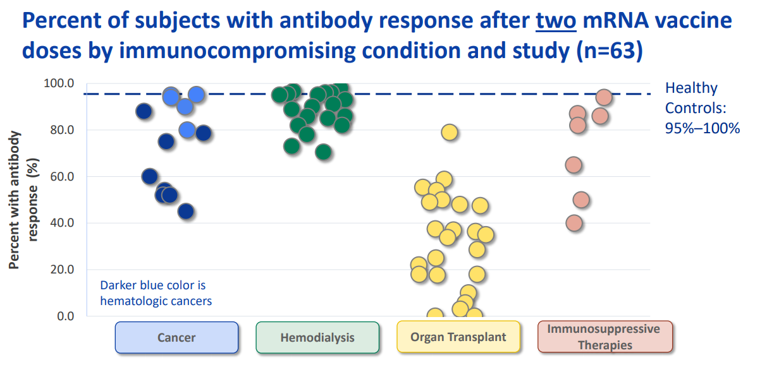
Sub-optimal vaccine responses
Percent of subjects with antibody response after two mRNA vaccine doses by immunocompromising condition and study (n=63)
https://www.cdc.gov/coronavirus/2019-ncov/science/science-briefs/fully-vaccinated-people.html

Slide 5

Part 1: REPURPOSED DRUGS
Niclosamide
Placebo niclosamide*
Dialysis
Renal Tx
Placebo Ciclesonide *
Vasculitis/GN
Ciclesonide
PROTECT
Prophylaxis in
Vulnerable Individuals
Part 2: NOVEL AGENTS
eg. monoclonals/antivirals
N=880
N= 880
Sotrovimab
Individuals with sub-optimal vaccine responses
Placebo (saline)
Agent D
Notes:
Do we still need this slide?

Slide 6
PROTECT
Prophylaxis in
Vulnerable Individuals
Part 2: NOVEL AGENTS
e.g. monoclonals/antivirals
N=880
N= 880
Sotrovimab
Individuals with sub-optimal vaccine responses
Placebo (saline)
Agent D

Slide 7
Sotrovimab
Monoclonal Ab derived from antibody isolated from SARS-CoV-1 survivor¹
Binds to highly conserved epitope on receptor binding domain of both SARS-CoV-1 and SARS-CoV-2
COMET-ICE – Phase II/III early COVID infection – 85% reduction in progression of COVID-19 disease
1. Pinto D, et al. Nature. 2020;583:290–5; 2. Cathcart AL et al. bioRxiv preprint doi: https://doi.org/10.1101/2021.03.09.434607

Slide 8
Sotrovimab – why?
Prolonged half life
Increased respiratory mucosal distribution
High barrier to viral resistance
Sotrovimab retains activity against all known variants of concern
  Omicron BA.2 confers 35-fold change in EC₉₀
So why are we still using Sotrovimab?

Slide 9
Ongoing rationale for using Sotrovimab
Increase in dose to 2g and reduced primary end point to 12 weeks
Data to suggest ongoing neutralisation of BA.2, BA.2.12.1, BA.4 and BA.5¹
Other potential mechanisms of mAb action other than neutralisation (e.g. opsonisation)
¹Wu M et al. Lancet. 2022 Oct 6:S0140-6736(22)01938-9. doi: 10.1016/S0140-6736(22)01938-9

Slide 10
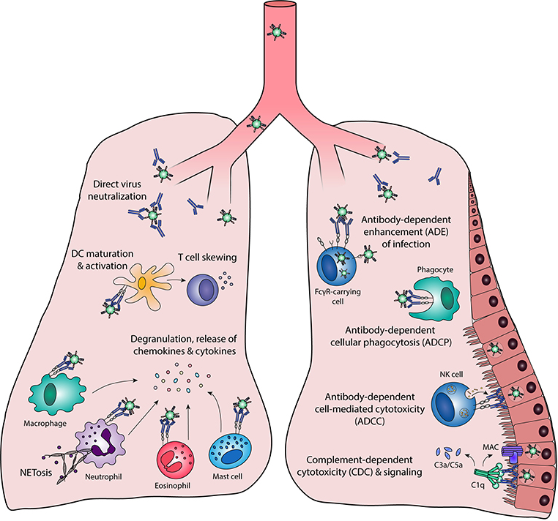

Front. Immunol., 22 March 2019 | https://doi.org/10.3389/fimmu.2019.00548

Slide 11
Eligibility – Inclusion Criteria
18 years or older
Written informed consent
Patient groups
  Dialysis
  Oncology, Haematology-Oncology or Haematology patients who are immunocompromised
  Primary immunodeficiency patients
  Solid organ and haematopoietic stem cell transplant recipients
  Any patient with a diagnosis of an autoimmune/inflammatory disease currently receiving immunosuppression who has received Rituximab or Alemtuzumab in the last 12/12 (Rheumatology/Respiratory/Gastroenterology/Neurology etc)

Slide 12
Eligibility – Exclusion Criteria
Inability to provide informed consent or to comply with trial procedures
COVID-19 at time of enrolment
Pregnant, trying to conceive, unwilling to use contraception or breastfeeding
Participation in another interventional prophylactic or vaccine trial against COVID-19.
Not in best interests to take part (e.g. limited life expectancy)
History of hypersensitivity to sotrovimab, one of its excipients or other monoclonal targeting SARS-CoV-2
History of receiving any monoclonal targeting SARS-CoV-2 within last 6/12
Acute admission to hospital in the last 2/52
CAR-T therapy in last 4/52
Patients are eligible if they have received SARS-COV-2 vaccination as part of their routine care.

Slide 13
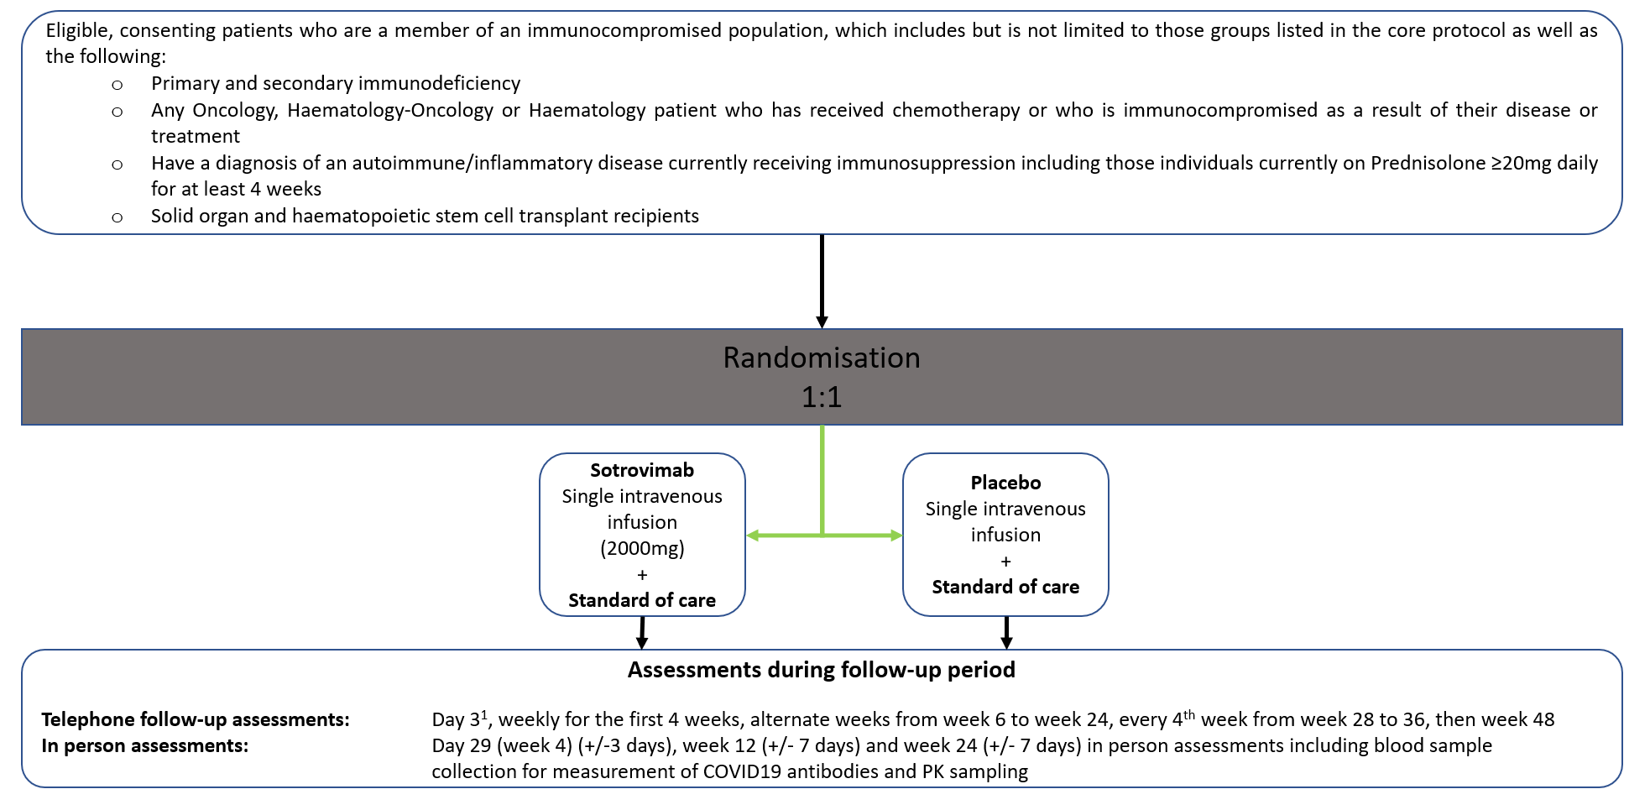
Trial assessments
¹Visit only necessary for lead-in cohorts

Slide 14
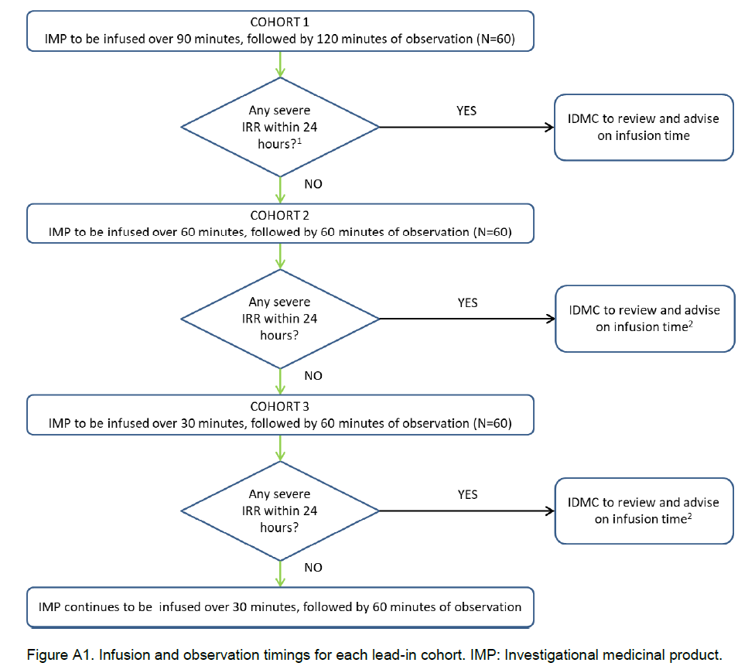
Lead-in cohorts
COMPLETE
no safety concerns

Slide 15
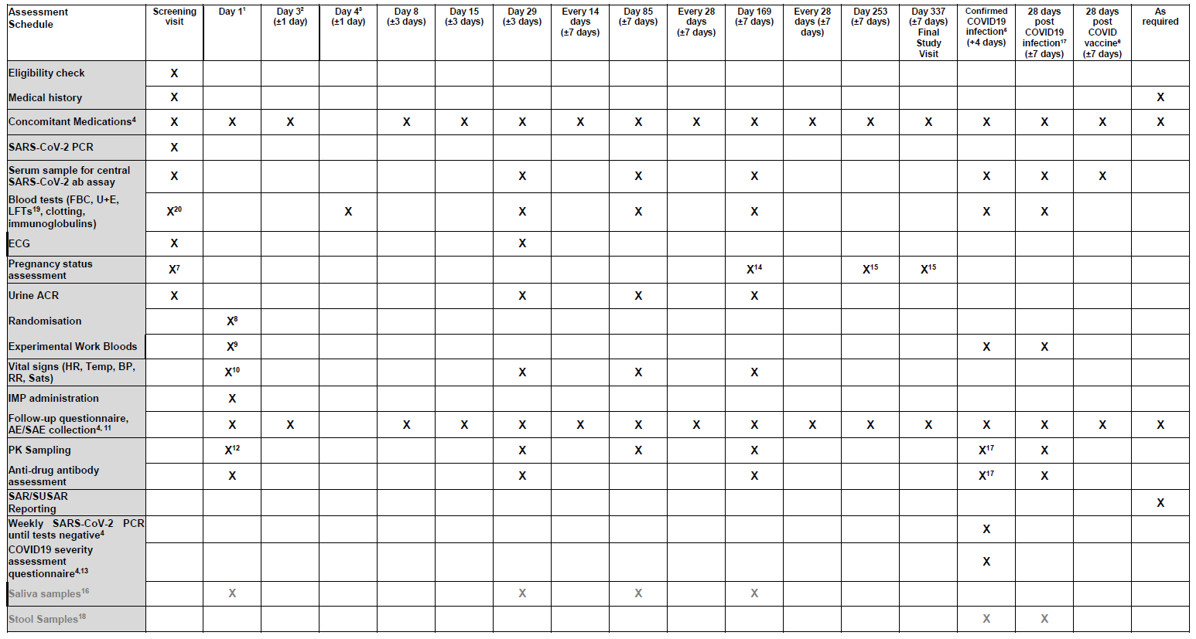
Schedule of Assessments

Slide 16
Schedule of Assessments

Slide 17
Screening visit
Written informed consent
Eligibility checklist, Baseline Medical History, Concomitant Medications log
Samples to local lab
  SARS-CoV-2 PCR or lateral flow test (LFT)
  Full blood count, clotting, renal and liver function*
  Serum pregnancy test in WOCBP
  Urine albumin creatinine ratio
  IgA, IgG, IgM to be collected as part of sample analysis, however, if it is not feasible, it should be taken on Day 1 prior to IMP infusion
SARS-CoV-2 antibody blood sample to be taken and sent for centralised processing in Clinical Immunology Service (CIS), UoB.
Perform an ECG.
*Routine ALT/AST tests performed up to 2 week before screening are acceptable to assess liver function

Slide 18
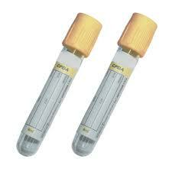
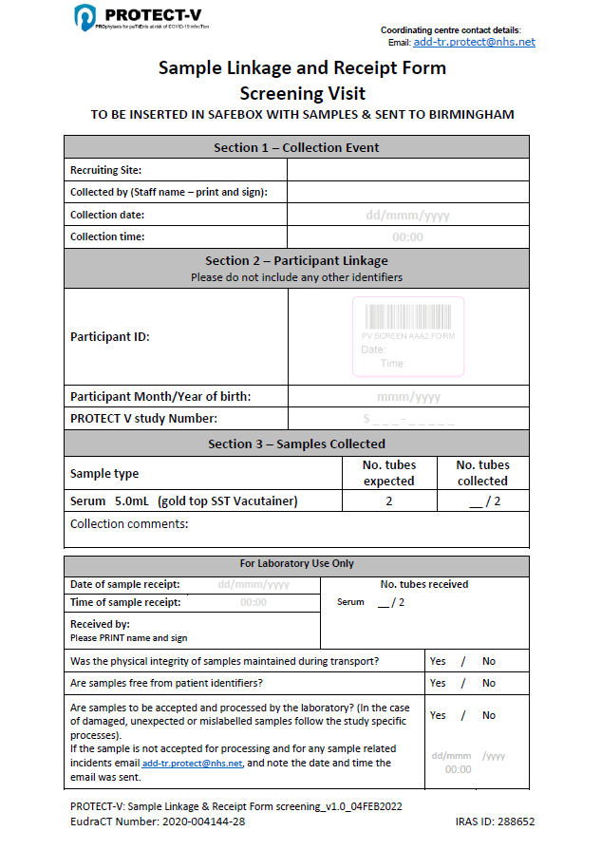
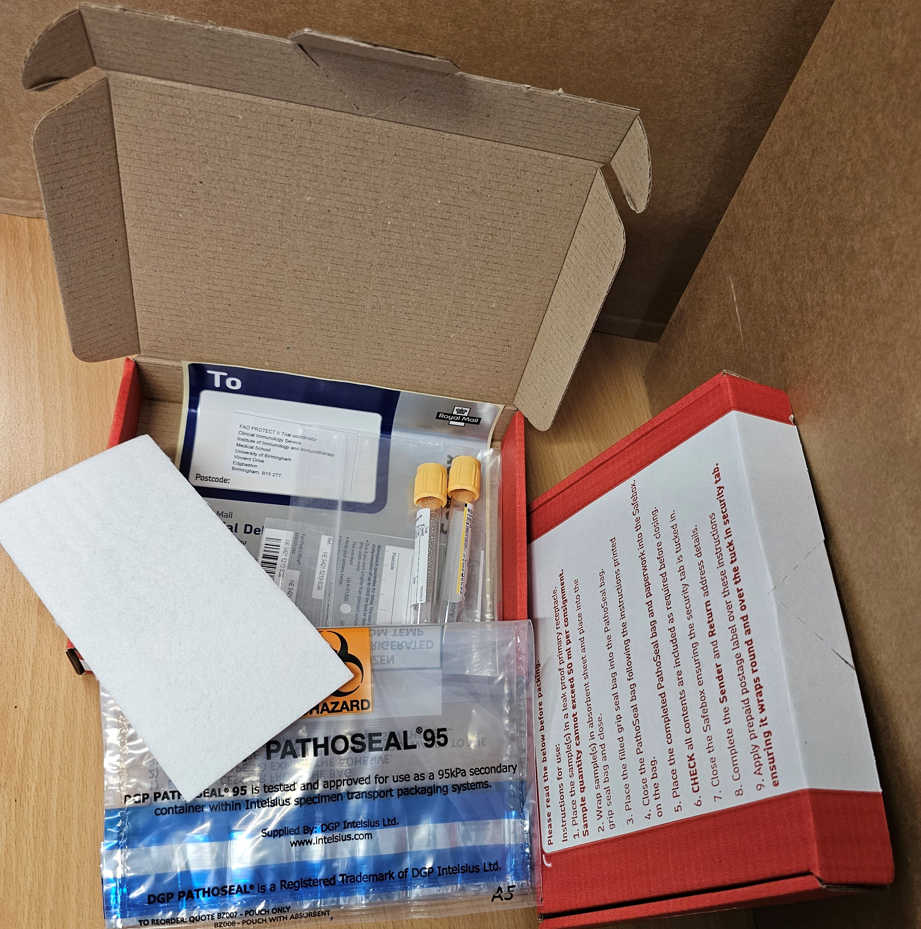
SARS-CoV-2 antibody blood sample
University of Birmingham Lab

Slide 19
Randomisation
Eligibility declaration must be signed by PI or delegated clinician before randomisation
Can be performed any time between the screening visit and Day 1 – screening and Day 1 visit may occur on the same day
Uses sealed envelope system

Slide 20
Day 1 – infusion visit
Must be within 14 days of screening
Complete a set of observations and record in CRF.
Insert cannula
Pre-infusion:
                - Blood samples for experimental medicine²
                - Blood sample for ADA¹
                Blinded member of staff to administer study medication
Post-infusion:
              - Observe patient for 1 hour post-infusion
              - Record obs in CRF
              - Blood sample for PK within 1 hour of infusion completion¹
¹See PPD lab manual
²Samples to BRC Cell Phenotyping Hub, Cambridge

Slide 21
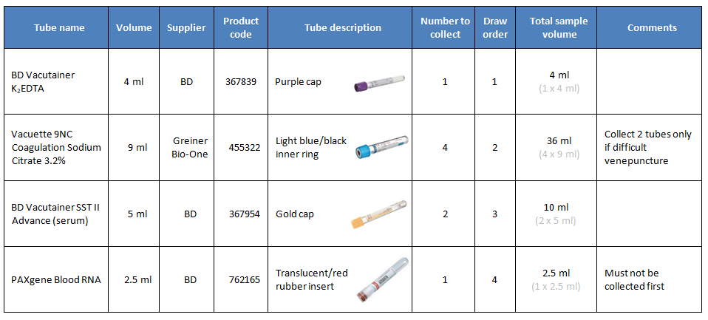
Day 1 Samples – Experimental work
No processing required. Deliver to Samples to CIS, UoB.

Slide 22
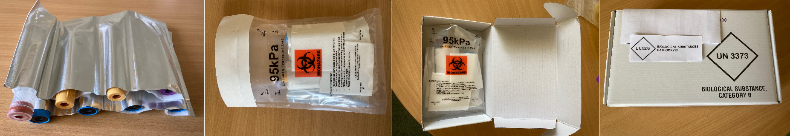
NEED TO BE COURIERED

Slide 23
Day 29 visit
Observations
ECG
SARS-CoV-2 antibody blood sample to CIS²
Blood samples for FBC, renal, clotting and liver function to be sent to local laboratory
Urine sample sent to local laboratory for ACR
Blood sample for PK analysis and anti-drug antibody assessment¹
Update Concomitant Medications log.
Record AEs or SAEs as necessary
IgA, IgG, IgM to be collected as part of sample analysis
¹See PPD lab manual
²Samples to Clinical Immunology Service, UoB

Slide 24
Day 85 visit
Observations
SARS-CoV-2 antibody blood sample to CIS²
Blood samples for FBC, renal, clotting and liver function to be sent to local laboratory
Urine sample to local laboratory for ACR
Blood sample for only PK analysis¹
Update Concomitant Medications log
Record SAEs as necessary
IgA, IgG, IgM to be collected as part of sample analysis
¹See PPD lab manual
²Samples to Clinical Immunology Service, UoB

Slide 25
Day 169 visit
Observations
Update Concomitant Medications log
SARS-CoV-2 antibody blood sample to CIS²
Blood samples for FBC, renal, clotting and liver function to be sent to local laboratory
Urine sample to local laboratory for ACR and Pregnancy test for WOCBP
Blood sample for PK and ADA analysis¹
Record SAEs as necessary
IgA, IgG, IgM to be collected as part of sample analysis
¹See PPD lab manual
²Samples to Clinical Immunology Service, UoB

Slide 26

ADA and PK samples
Day 1
Anti-Drug Antibody – pre-infusion
PK – within one hour of infusion finishing
Day 29
ADA and PK
Day 85
PK only
Day 169
ADA and PK
NB SEPARATE PPD COURIER
Page 32 – study specific information

Slide 27
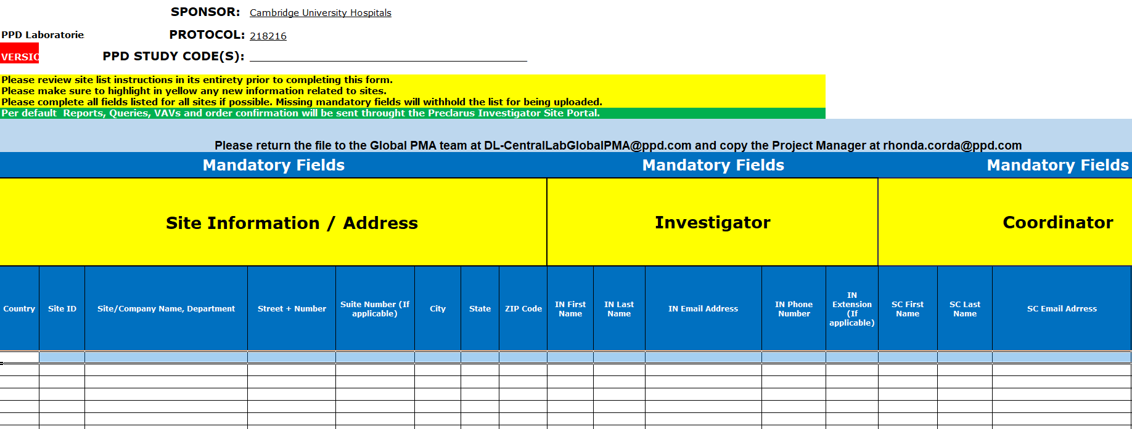
Registration with PPD
This form below to be completed by site team (before activation) and returned to the CCTU.
Provided users will receive an email to set up an account, once setup users can provide other
local users access to the system

Slide 28
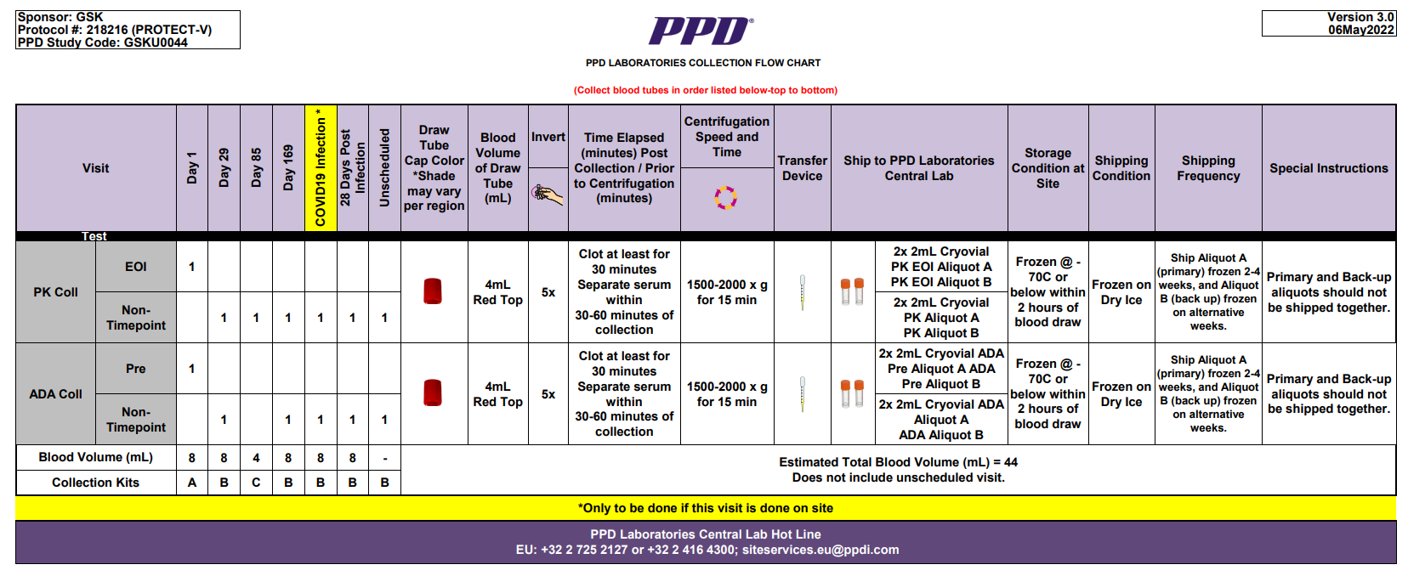
PPD Kits will include the above items
These can be ordered from the CCTU via add-tr.protect@nhs.net
Sites will also require a bar code scanner or mobile phone app to process barcodes
See GSK 218216 (PROTECT-V) Lab Manual V3 11 MAY 2022 for detailed process.

Slide 29
Telephone assessments
            Weeks 1 (Day 8), 2 (Day 15), 6 (Day 43), 8 (Day 57), 10 (Day 71), 16 (Day 113), 20 (Day 141), 28 (Day 197), 32 (Day 225), 36 (Day 253). Week 48 (Day 337) – Final study telephone call
Record if any SAEs
Update the concomitant medications log
Ask the participant about any COVID-19 vaccinations received
Ask about any symptoms suggestive of potential side effects of the trial medication

Slide 30
Unscheduled Assessments
If a patients develops symptoms suggestive of COVID-19
Participants are required to:
Arrange a COVID-19 test - if there is a difficulty in arranging this then they should contact their local site
Contact their local site and inform result of swab/LFT

Slide 31
COVID-19 infection during trial
All patients should receive SoC
Unblinding is not required

Slide 32
COVID-19 infection during trial
  Participant will be followed-up by telephone weekly by local site staff (COVID-19 symptom collection), please also follow up on the patient swabs to confirm they are being completed.
  Site to courier the following to subject’s home:
      1) Blood tubes (8 tubes), labels, UN3373 packing for experimental medicine blood tests*
      2) Blood tubes, local labels and request forms for FBC, clotting, renal and liver function (Safebox to local site lab)
      3) Swab packs for patients to self-swab at home (4 initially, further 4 if necessary) (Patient to perform at home and post in Priority post box weekly) – testing should be completed for up to 8 weeks, once two negative tests are confirmed, testing should stop. Patients consented to PIS V4.0 and above should collect a stool sample at weeks 1 and 4 (pots included in swab packs)
      IgA, IgG, IgM to be collected at Day 1 covid infection, and at 28 Day post covid infection.
*Addressed and couriered to BRC Cell Phenotyping Hub, Cambridge

Slide 33
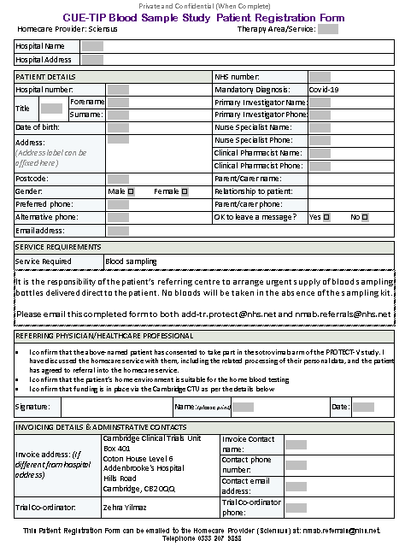

COVID-19 infection during trial
  If unable to accommodate COVID positive patient on site:
  Book in home nursing visit for phlebotomy services
  Email form to Sciensus
  Ensure sample collection tubes couriered to participant in advance of home nurse visit
  Book courier to collect samples after visit

Slide 34
COVID-19 infection during trial
  Arrange the 28-day post-infection, on-site visit

Slide 35
Unscheduled Assessments
If a participant has a COVID-19 vaccination
  Record date and type of vaccine
SARS-CoV-2 antibody blood sample to CIS 28 days (+/- 7 days) post-vaccination*
*Samples to Clinical Immunology Service, UoB
If a participant is offered a COVID-19 vaccination as part of the UK national COVID-19 vaccination programme, then they should be encouraged to accept the vaccination.

Slide 36
Primary outcome
Confirmed symptomatic COVID-19 infection during treatment
The primary outcome event is defined as the presence of both:
PCR/Lateral flow test confirmed SARS-CoV2 and
One or more symptoms in keeping with COVID-19, including:
  Respiratory (Cough +/- sputum and shortness of breath)
  Constitutional (Pyrexia/chills, myalgia/arthralgia, fatigue, rash, headache, confusion)
  Gastrointestinal (nausea/vomiting, diarrhoea, abdominal pain, loss of appetite)

Slide 37
Consent Process
Delegated member of trial team
Explain trial in detail and provide Participant Information Sheet (PIS) Informed Consent Form (ICF)
Enter details on patient approach log
Allow participant time to consider trial information
ICF must be signed before any research procedures are performed

Slide 38
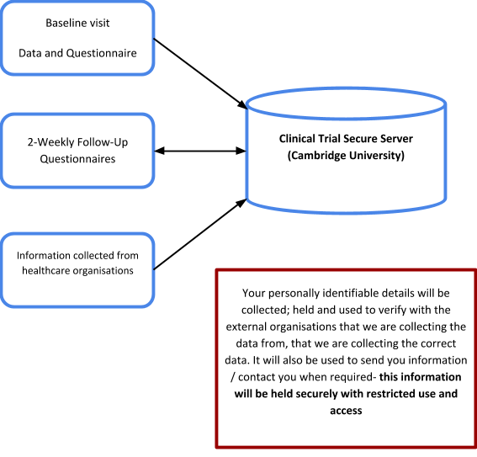
Patient Data and Consent
Consent to:
Trial participation
Data Linkage

Slide 39
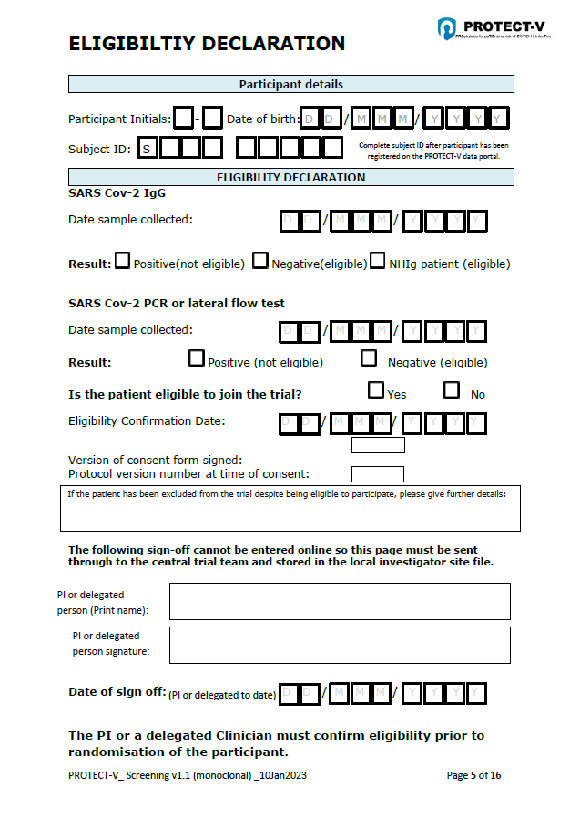
Eligibility Declaration
PI signature and date of sign off are not captured in the database. Please send a copy of completed Eligibility Declaration to add-tr.protect@nhs.net ideally within 3 working days of completion of eligibility assessment.

Slide 40
Randomisation
Randomisation can only occur after eligibility has been confirmed N.B. trial numbers are required for randomisation, these are provided by registering the participant on the PROTECT-V database.
Randomisations will be 1:1 to either sotrovimab or placebo
Randomisation using Sealed Envelope (SE): https://www.sealedenvelope.com/access
Participating site staff that have been delegated to randomise participants on the PROTECT-V Delegation Log, will be given login details to access the randomisation system by the central coordinating team
Minimum system requirements for accessing SE - Internet Explorer 8 or above; any version of Firefox, Chrome, Edge or Safari

Slide 41
Randomisation
Complete the data fields with the information captured in the CRFs
Once treatment is allocated, notification email will be sent to all delegated members of the team, with unblinded notification to pharmacy
Unblinded notification will only be sent to pharmacy and will not be sent to any other study team members
Trial prescription to be completed with the unique kit code
If SE is unavailable or cannot be accessed - contact the Clinical Trial Coordinator

Slide 42
Unblinding
Only when it is felt that knowing the participant’s treatment allocation will influence their care and treatment
Investigators to maintain their blind as far as possible.
The treatment allocation must not be disclosed to the participant and/or other personnel or recorded in trial documentation, unless it is necessary for the participant’s safety
Unblinding will be performed though SE by delegated research team members.

Slide 43
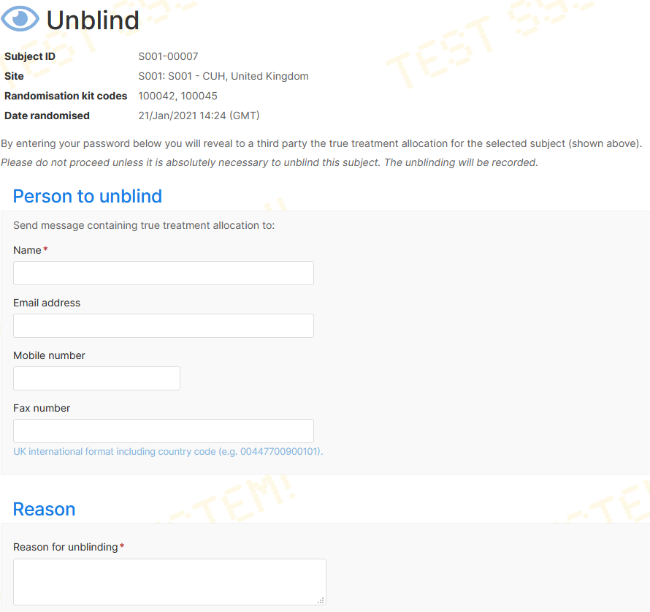
Unblinding
Login to SE and access PROTECT-V.
Trial personnel with both “Unblinder” and “Investigator” account must login and click the “Access” tab to switch between roles.
Navigate to Randomisations. Click on the participant to be unblinded. Select “Unblind”.
Complete the unblinding form

Slide 44
Unblinding
Treatment allocation will be sent to the email address indicated in the form. Unblinding notification without treatment allocation will be sent to all trial administrators and local investigators.
Unblinder to provide detailed explanation of the unblinding to the CI and Sponsor and to file the unblinding notification in the ISF
In case SE is inaccessible, contact the Clinical Trial Coordinator.
The responsibility to break the treatment code resides solely with the treating clinician

Slide 45
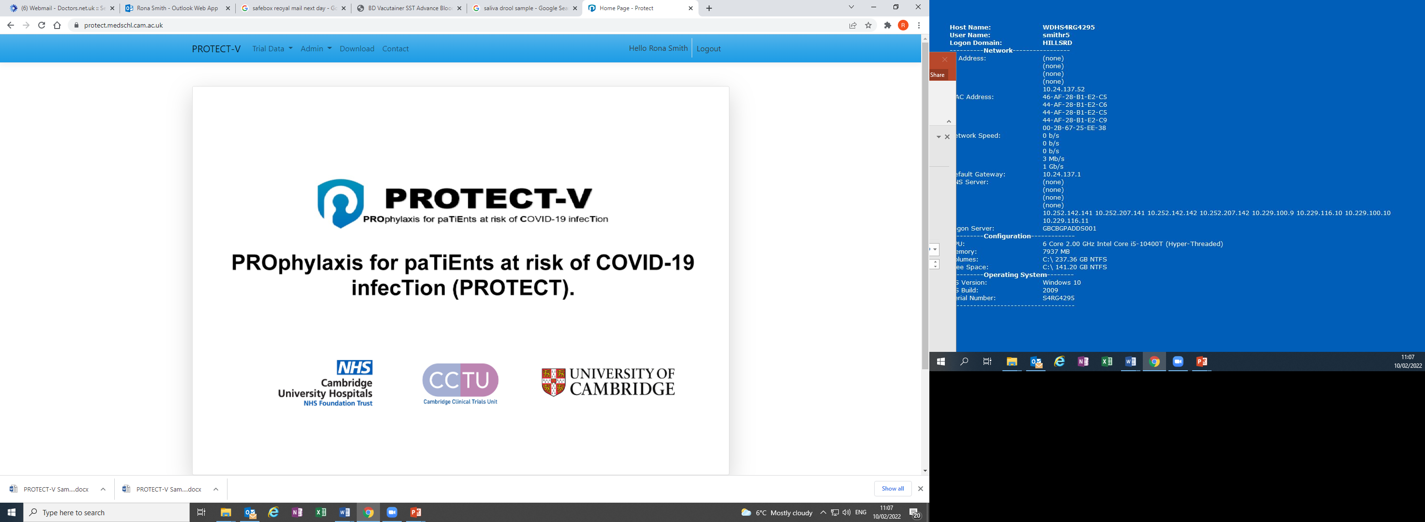
Trial data portal website(1)
Trial data portal website address is https://protectmonoclonal.medschl.cam.ac.uk/Account/Login
At site setup a list of users should be sent to the coordinator
Invitation to use the website will be sent by the Protect Trial Data Managers
Site staff are able to:
Register participants – REQUIRED TO ASSIGN PARTICIPANT TRIAL NUMBER.
Complete electronic CRFs (e-CRFs)
Download study information (protocol, blank CRFs etc)
Site staff will NOT be able to:
Edit data after submitting a form (will explain it further)

Slide 46
Trial data portal website(2)
Training
Trial training website address is: https://protectmonoclonaltrain.medschl.cam.ac.uk/Account/Login
After registration, access will automatically be provided to the PROTECT-V training website, which allows site admins to familiarise themselves with navigating the website and practice entering participant data. Any further training needed will be provided by Data manger.
Live
https://protectmonoclonal.medschl.cam.ac.uk/Account/Login

Slide 47
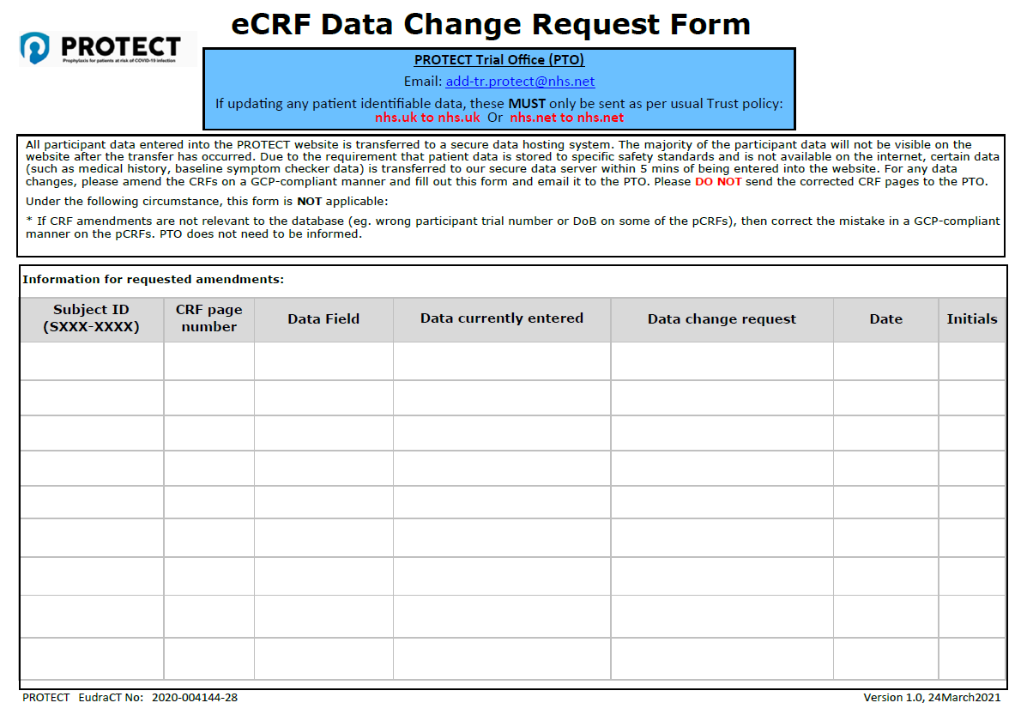
Trial data portal website(3)
Important points to know:
Data will be transferred to the trial secure data host system in a few minutes after clicking the “Save”.
After this point, seeing or editing data will not be possible. Therefore please pay extra attention to the data entered and double check the accuracy before saving it.
eCRF/Database corrections can be requested by completing the eCRF Data Change Request Form.

Slide 48
Investigator Responsibilities
Patient accruals – consent, registration and randomisation
ISF maintenance
Evidencing delivery of continual trial team training (GCP/protocol/trial procedures)
Delegation log maintenance
Responding to data queries in a timely manner
On-going safety and pregnancy reporting
Escalating conduct issues and protocol deviations immediately to the PTO
Local oversight of trial conduct

Slide 49
Pharmacovigilance
For any questions regarding
Safety Assessment refer to the
Protocol
(Section 5) & Appendix A-C

Slide 50
Evaluation of Safety Data:
AEs, AR, SAEs, SARs, SUSARs
Seriousness
Assessment
  Refer to the protocol, section 5.1
Causality
Assessment
Related-Unrelated
  Refer to the protocol, section 5.3.2
Expectedness
Assessment
Refer to the protocol Appendix C for Sotrovimab
Severity
Assessments
  Refer to the protocol, section 5.3.3

Slide 51
SOTROVIMAB AEs Management
Adverse events (serious non serious) will be collected & recorded:
From the point of Informed Consent until Day 29, for the Sotrovimab arm only
For this trial the Reference Safety Information is: Union Therapeutics Investigator Brochure for UNI911 (Niclosamide nasal spray), Version 1.0, 26th August 2020 section 6.1.
Beyond Day 29: Only serious & non serious AESI will be collected until the final study visit on day 337:
-Hypersensitivity reactions (including skin reactions and bronchospasm) at any time after IMP infusion
- Infusion-related reactions within 24 hours after IMP infusion (including pyrexia, chills, dizziness and dyspnoea)
- Antibody dependent enhancement (ADE) of disease in those who reach the primary end-point will be assessed
All SAEs will be submitted within 24 hours using study SAE form:
- Since site awareness date to the CI / Coordination Team
- Since CI/Coordination Team notification to Sponsor
The Chief Investigator will ensure that all safety information is reported to GSK when sponsor review is complete

Slide 52
SOTROVIMAB REFERENCE SAFETY INFORMATION
Investigator’s Brochure for VIR-7831 – Treatment and prevention of COVID-19, Edition 3, November 2021, Section 6.6.2.
Notes:
AEs, ARs and SAEs should be recorded in the:
Medical notes and the appropriate section of the CRF
and/or AE/AR log.

Slide 53
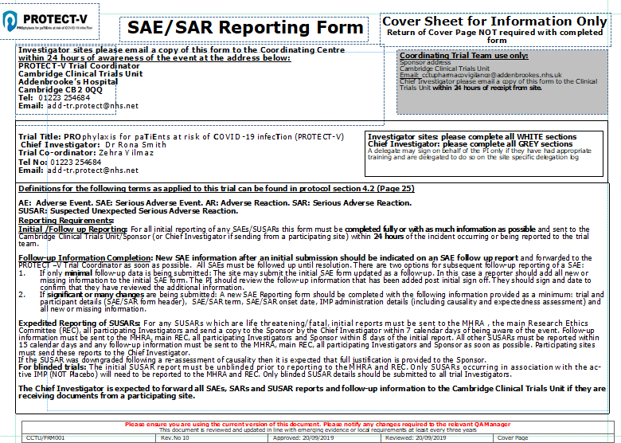
SAE/SAR Reporting form
  Contact details
  Initial reporting requirements
  Follow up reporting requirements
  Expedited reporting of SUSAR
Notes:
Hospitalisation scheduled planned before participant entered the trial will not be recorded as an SAE unless underlying event/condition worsens during the trial. Abnormal laboratory test results will not be recorded and/or reported as AEs unless they meet the criteria for a SAE . Abnormal laboratory test results should be recorded in the medical notes. Deaths with an unknown cause should always be reported as a SAE.

Slide 54
PROTECT-V Pregnancy Reporting Requirements
Study Participant Pregnancies Will Be Collected
For the duration of the follow-up period
Pregnancy should be reported within 24 hours of site awareness to:
CI, Trial Coordination team, Sponsor
The CI will report pregnancies:
To GSK for SOTROVIMAB
Notes:
.
Spontaneous abortion is always considered an SAE and reported as such.
If any of such problems will be found to be related to IMP then they may meet an expedited report (SUSAR) criteria

Slide 55
Monitoring

Slide 56
Monitoring - purpose
The act of overseeing the progress of a clinical trial, and of ensuring that it is conducted, recorded, and reported in accordance with the protocol, SOPs, GCP, and the applicable regulatory requirement(s)
Trial monitoring is an Integral Component of trial quality assurance process, and critical for GCP fulfilment.

Slide 57
Non-compliance reporting
Non-reportable
Type 1: These involve a departure from the precise wording of the protocol, SOP or regulatory requirements that has been identified retrospectively and has minimal impact on the integrity of the trial.
Reportable
Type 2: Departure from the protocol, SOP or regulatory requirements that has been identified retrospectively and, is not likely to effect to a significant degree:
The safety, or physical or mental integrity of the trial subject
The scientific value of the trial
Type 3: Departure from the protocol, SOP or regulatory requirements which is likely to effect to a significant degree:
The safety, or physical or mental integrity of the trial subject
The scientific value of the trial

Slide 58
Non-compliance reporting
If the non-compliance is reportable, the site must complete a non-compliance report and send it to the central coordination team for review. The Sponsor will determine if the non-compliance is Type 2 or Type 3
The non-compliance report should then be sent to the sponsor for assessment. The sponsor will confirm the correct categorisation and determine whether the incident is a potential serious breach
Non-compliance log must be kept and updated routinely at site
A copy of the non-compliance log should be provided to the coordinating team every two months

Slide 59
Non-compliance reporting examples
Any singular non-consecutive missed telephone consultation that occurs after Day 29 will not be recorded as a protocol non-compliance and will considered missed data only.
Any three or more consecutive telephone calls missed after Day 29 should have a PNC form completed and forward to the central coordinating team.
Both day 8 and day 15 phone calls missed should have a PNC form completed and forward to the central coordinating team
Out of window visits due to patient factors OR factors outside site control are now categorized as a type 1 PNC
Notes:
Christmas lab closures are outside site control

Slide 60
Monitoring participating site
Remote monitoring of sites will be performed by the CTC or delegate approximately every 4 months from site activation (Remote monitoring calls at months 4 & 8 followed by remote monitoring form being completed at month 12).
The site will be instructed to complete a remote monitoring report form and return it to the CTC within 4 weeks
The remote monitoring report may be completed by any site trial team member listed on the delegation log, but must be reviewed and signed-off by the PI.
Following a review of the returned monitoring report, the site will be provided with a report containing details of any findings and required actions to be taken by the site, which must be addressed within 4 weeks.

Slide 61
Monitoring participating site cont.
File the completed remote monitoring documents with pertinent correspondence in the ISF
The frequency of remote monitoring may change depending upon the rate of patient recruitment at the site, quality of the data and the findings from previous monitoring
Unsatisfactory findings may result in the escalation of remote monitoring to on-site monitoring visits by the trial team and/or Sponsor. On-site monitoring will be prioritized for participating sites based on outputs of central monitoring
Triggered Monitoring – 20 & 50 participants recruited and any serious safety breaches
Notes:
On-site monitoring will be based on the on-going risk assessment of the study and review of the fortnightly TMG progress reports and other standard central data monitoring metrics. On-site monitoring will be prioritized for sites that demonstrate patterns of non-compliance (such as poor IMP adherence) or considered to be an outlier (such as high level of participant withdrawals)
Documentation reconciliation will be performed by the CTC for every participating site 12 months after site activation
Triggered Monitoring:
Significant Serious Breaches reported at site
Safety Reporting
Particularly few SAEs
Particularly many SAEs
Number of patients recruited
Particularly low
Particularly high
Persistent non-compliance
Poor resolution of monitoring findings
Poor communication
Participating site with coordinating team
Coordinating team with sponsor
High data query rate or re-queries, particularly those related to eligibility, safety and primary endpoint data
At the request of coordinating team/ Participating site team

Slide 62
Site Initiation Checklist
Fully executed site agreement
Localised site-specific documents (PIS/ICF, GP letter, Patient ID Card)
Signed delegation and training logs log
PI’s current GCP certificate and CV (hand-signed and dated)
Investigator and Pharmacy Site Files (ISF & PSF) (will be sent by the PTO)
Site initiation visit (SIV) form (will be sent by the PTO and requires PI’s signature)
Out-of-hours emergency cover test
Site activation on trial web portal
Local R&D C&C
Site activation letter sent to PI → open to recruitment

Slide 63
Central PROTECT-V Team
Trial Manager
Mr Francis Dowling – francis.dowling@nhs.net
Chief Investigator
Dr Rona Smith – ronasmith@doctors.net.uk
You will also be assigned your own personal site specific trial coordinator, this will be confirmed in the SIV meeting.
add-tr.protect@nhs.net

Slide 64
Pharmacy: Sotrovimab

Slide 65
IMP Documents provided to site pharmacies
Pharmacy manual (contains label, sample IxRS notification)
Template inventory/accountability logs
Template prescription form
MSDS
Temperature excursion reporting form

Slide 66
IMP manufacture: Sotrovimab 500mg vial (62.5mg/ml)
IMP manufacture and packing of commercial stock by GSK/ VIR (EU)
Importation, trial labelling and QP certification performed by Eramol (UK)
Sotrovimab is a fully human IgG1κ monoclonal antibody (mAb) derived from the parental mAb S309, a potent neutralising mAb directed against the spike protein of SARS-CoV-2
  Sterile, unpreserved formulation for dilution. Single use.
  Currently 30 month expiry – stability testing ongoing and planned extension up to 60 months (depending outcome of analysis).
  Sotrovimab is a clear, colourless or yellow to brown solution, free from visible particles
Stored at monitored fridge temperature 2-8°C
Supplied unblinded to site pharmacies, all IMP dispensing by unblinded site pharmacy

Slide 67
IMP distribution to sites (1)
Released commercial product will be shipped to Sponsor - appointed 3rd party: Eramol
  Eramol will perform import and UK QP oversight as required by IMP being transferred from named countries
  Labelling: Eramol will apply Annex 13 compliant trial specific labelling to the vial and outer carton and QP release.
  Expiry date extensions: Plan not to relabel any trial labelled stock but to issue a memo to sites regarding extended expiry
Eramol will store and distribute to all UK sites upon order by site: 2-4 day lead time
QP certification: will be provided for each batch

Slide 68
IMP distribution to sites (2)
Initial shipment to site will be triggered by sponsor upon site activation: COORD to notify Eramol: usually a minimum of 40 vials (target dependant)
Ongoing shipments will be ordered by site pharmacist who should maintain levels of at least 5 doses (20 vials) depending on site storage capacity and recruitment targets
COORD to be cc’d into each IMP order and confirmation
Vial dimensions in pharmacy manual
Site pharmacist may amend site orders in line with recruitment levels and shelf-life of IMP available

Slide 69
IMP receipt at sites (1)
IMP will be shipped to local site pharmacy who will confirm if transit conditions were satisfactory (datalogger with each shipment)
Receipt documentation to be completed and returned to Eramol, cc: COORD
If IMP is NOT in satisfactory condition at receipt and requires quarantining pending confirmation of fit for use, site pharmacy must contact COORD for further action
When shipping new batches (i.e. different expiry), sites should use stock with shortest expiry first
NB where the labelled expiry is extended Sponsor can provide a Memo to sites to confirm the new expiry of the batch

Slide 70
IMP temperature excursions at site
IMP must be stored at 2-8°C (rounding is permitted, i.e. 1.5°C to less than 8.5°C are not classed as excursions and do not require reporting)
All excursions must be notified to COORD using the provided temperature excursion report form and stock quarantined as per local procedure
COORD will investigate whether IMP remains fit for use (FFU) and maintain full audit trail to batch level. Vials are not individually numbered therefore sites need to mark vials that have been exposed to an excursion
Decision provided to local site in writing
  If NOT Fit For Use (FFU), sponsor to authorise site to destroy/dispose of IMP
  If FFU, site may remove from quarantine as per local SOP

Slide 71
Shelf-life/Expiry of IMP
Initial expiry of 18th August 2023: this has been extended to 18th February 2024. Relabelling at site to be considered, memo to sites will be provided.
Site pharmacist will maintain oversight of IMP stock at sites and ensure there is sufficient IMP with appropriate expiry. Sites to inform COORD immediately if insufficient in-date stock levels and expected delivery not received.
Expired stock at sites which is not to be extended further is to be destroyed at site upon approval of COORD

Slide 72
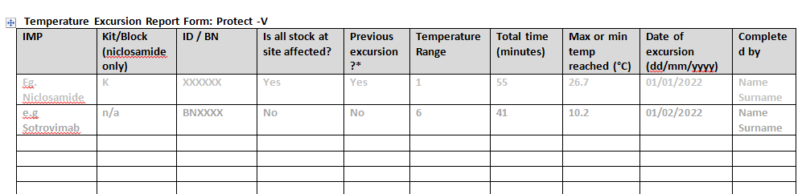
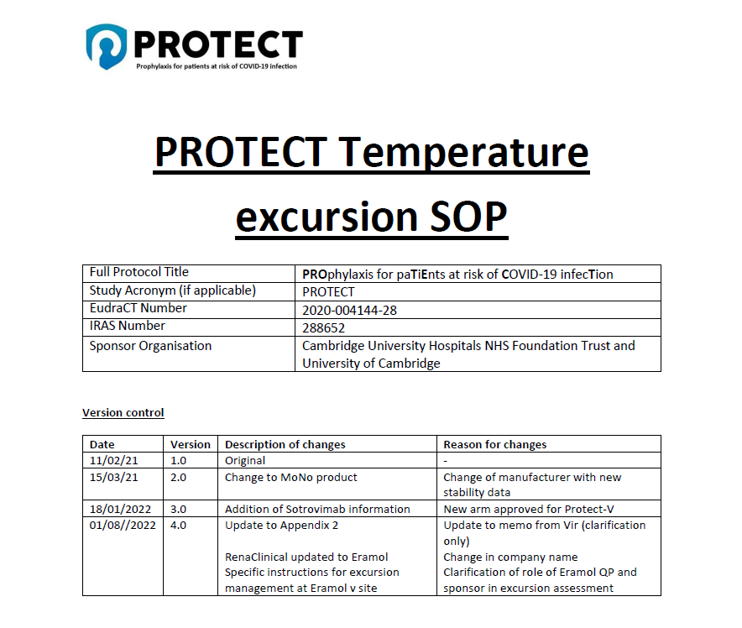
Temperature excursions
Reported using Temperature excursion form to COORD
COORD to refer to temp excursion SOP for Protect V and relevant IMP
Support from Vir/GSK can be requested

Slide 73
Prescribing of IMP
Template prescription provided: sites permitted to use local version
Prescribed in advance by delegated prescriber
Prescription must state intended date of treatment to be supplied
Sealed Envelope allocation does not need to accompany prescription as pharmacy will receive unblinded allocation directly

Slide 74
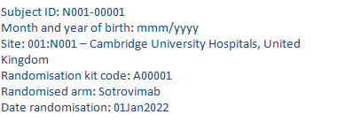
Sealed envelope notifications
Pharmacy will receive unblinded SE notifications:
Pharmacy staff should check against the concealment list provided that the randomisation kit code matches the code described on the notification and sign on the printed notification to confirm the check.
This notification should only be printed and filed by pharmacy and not sent with the dispensed IMP. Blinded notification will contain the kit code which blinded staff can cross reference to blinded IMP.

Slide 75
Collection of dispensed IMP
Unblinded nursing staff to collect IMP from central pharmacy – sign prescription
Pharmacy to dispense either Sotrovimab and saline bag or just saline bag if on placebo.
Provide correct worksheet for preparation and IV bag labels
Cover items in an opaque bag before transport to ward area – supply a copy of the prescription. Do not supply the sealed envelope unblinded notification
Ancillaries (0.2micron filter) to be obtained at ward level or pharmacy (sites discretion)
IMP should not be stored in ward areas prior to preparation unless authorised by pharmacy

Slide 76
Preparation of IMP (active)
Preparation for dilution of active drug (ward level instructions)
Remove four vials of sotrovimab from the refrigerator (2°C to 8°C). Allow the vials to equilibrate to ambient room temperature, protected from light, for approximately 20-30 minutes.
Visually inspect the vials to ensure they are free from particulate matter and that there is no visible damage to any of the vials. If any of the vials are identified to be unusable, request replacement vials.
NB Damaged vials should be returned to pharmacy if sealed. If not sealed take a photo and report to TC.
Gently swirl the vials several times before use without creating air bubbles. Do not shake or vigorously agitate the vial.
Dilution instructions
Withdraw 32 mL from an infusion bag containing 100mL of sodium chloride 9 mg/mL (0.9%) solution for injection.
Withdraw 8 mL from each vial of sotrovimab – total volume 32mL .
Inject the 32 mL of sotrovimab into the infusion bag via the septum.
Discard any unused portion left in the vials. The vials are single use only and should only be used for one patient.
Prior to the infusion, gently rock the infusion bag back and forth 3 to 5 times. Do not invert the infusion bag. Avoid forming air bubbles.
Label the infusion bag.
Once the preparation has been second checked, place the bag into a labelled, opaque cover bag.
Used vials can be discarded in ward medicine bins. Empty cartons to be retained and returned to pharmacy. Record the time the first vial was punctured on the infusion bag label using a permanent black marker.
NB Worksheets will be provided

Slide 77
Preparation of IMP (placebo)
No dilution or volume withdrawal required.
Inspect bag for particles and check expiry date
Seal septum
Complete label NB ensure expiry is 6 hours (if not being refrigerated and prepped in aseptic unit)
Ensure time taken is similar to that for active preparation and second check is completed.
Cover with opaque bag and label outer.
For immediate use – store at room temperature
NB Worksheets will be provided

Slide 78
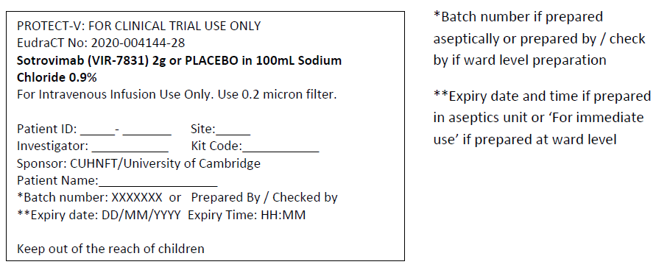
IV bag label text (blinded)
Label text for final blinded product (applied at site level)
NB. Product should be used immediately if prepared at ward level – stable for up to 6 hours at room temperature. Use 6 hours as expiry time from time of preparation. If prepared in aseptic unit and refrigerated, expiry should be 24 hours.
Labels will be provided by pharmacy

Slide 79
Administration of IMP
Prepared infusion to be handed to blinded member of team as per SOP and SBP.
NB if it is trust policy to only allow the staff member who prepared the infusion to set up the infusion then this is permissible, if documented in the approved site blinding plan.
Sign on prescription to confirm receipt of blinded product, check kit number is correct against blinded sealed envelope randomization
If the prepared infusion bag was prepared aseptically and refrigerated prior to administration, prepared infusion bag must be brought to room temperature prior to administration (approx. 20-30 minutes).
Infusion of the prepared infusion bag, including flush of line, must be completed within 3 hours of removal from refrigeration and within the expiry time stated on the label.
Blinded team member to attach an infusion set to the infusion bag using standard bore tubing.
The solution is recommended to be administered with a 0.2 μm in-line filter.
Prime the infusion set and administer as a single IV infusion for 30-90 minutes (depending on arm cohort) at room temperature.
Treatment must not be administered as an intravenous push or bolus.

Slide 80
IMP administration at other sites
Some sites require the nurse who has made up the IMP (the unblinded nurse) to administer the IMP
In this scenario sites should document in their SOP and/or Site Blinding Plan how they intend to ensure the blind is not broken in this instance.
Any unblinded staff member who administers IMP must have no further involvement with the patient after this point

Slide 81
IMP returns
Pharmacy to receive back all unused IMP and empty cartons
Return all unblinded worksheets for filing
Used vials:
These can be discarded following preparation checks and reconciliation without any further monitoring verification (ensure discarded vial not visible to blinded staff)
Unused vials and expired stock:
These should be stored separately until verified by the study monitor and approved for destruction, destruction to be documented on a destruction log.
Unused vials may not be returned to inventory for further dispensing.

Slide 82
Emergency unblinding
Emergency unblinding to be carried out by clinical team using IWRS
Pharmacy will not be involved in this process (including OOH)
OOH: Out of Hours

